Slide 1
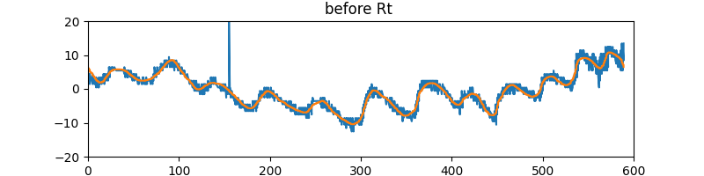
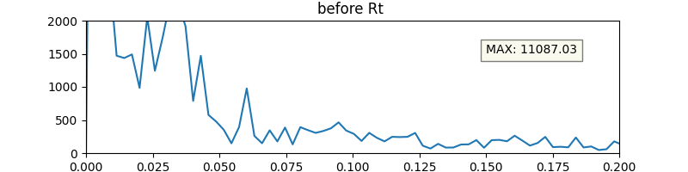
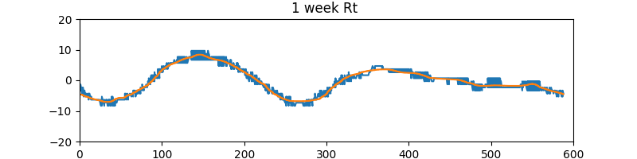
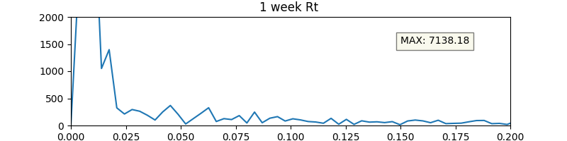
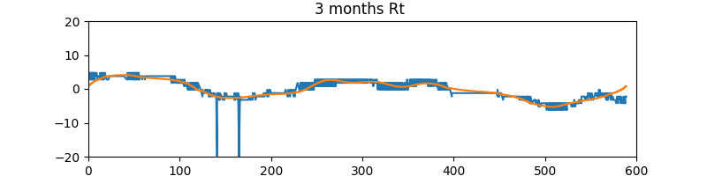
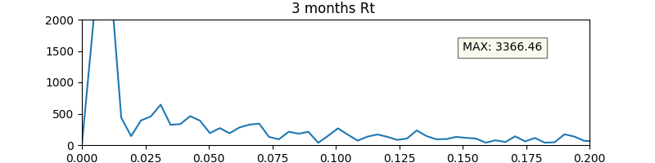
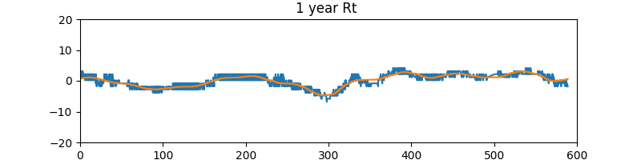
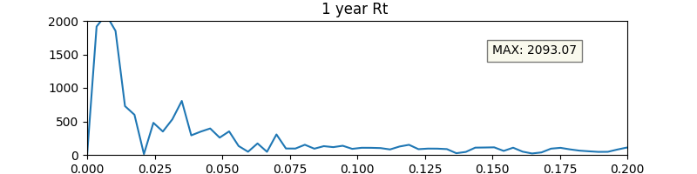
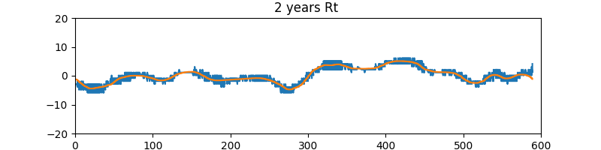
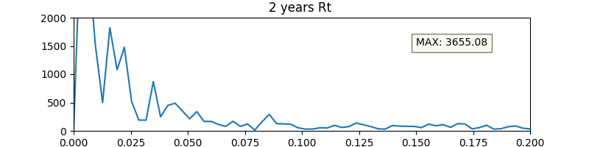
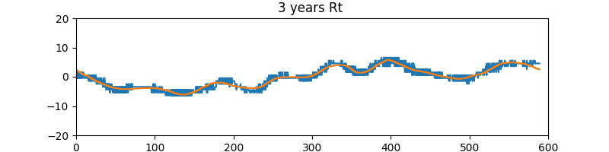
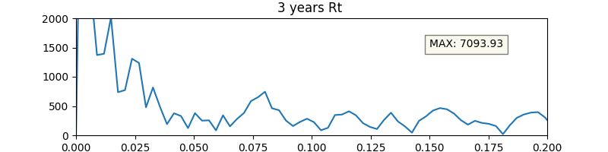
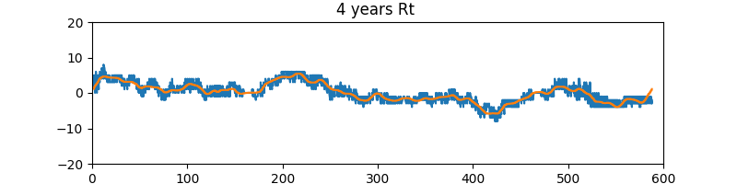
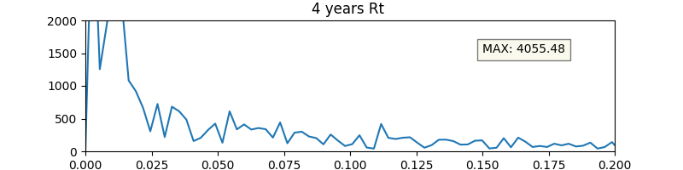
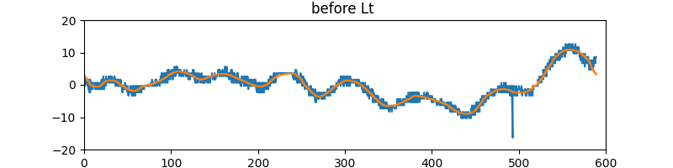
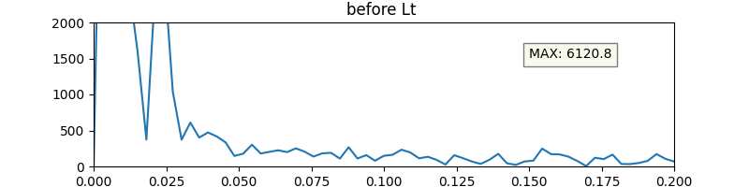
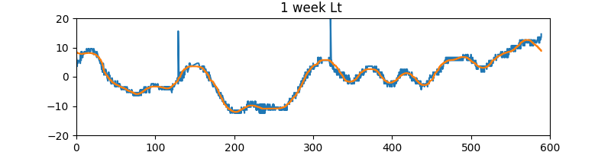
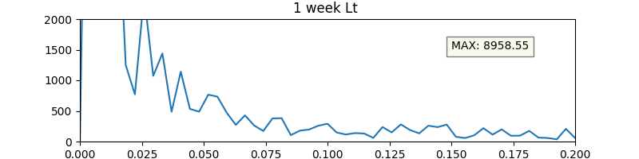
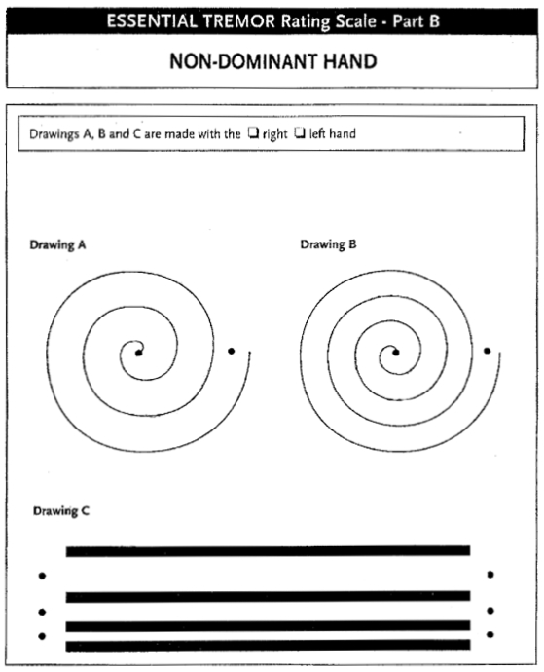
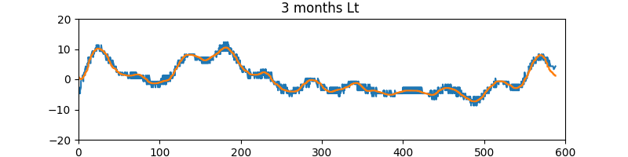
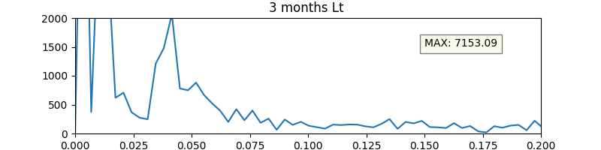
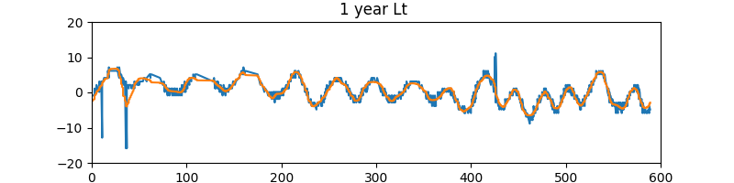
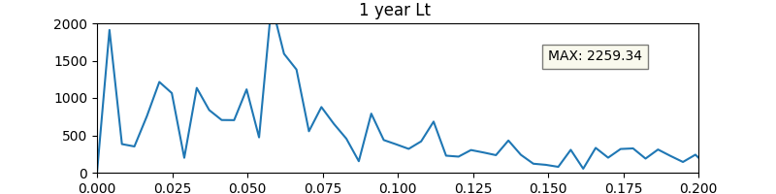
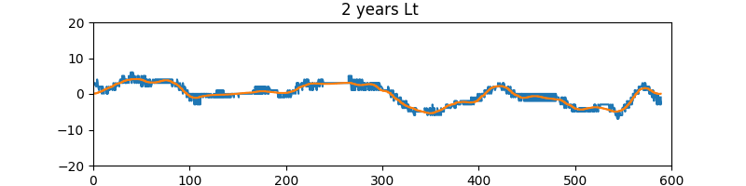
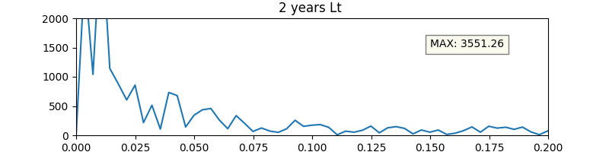
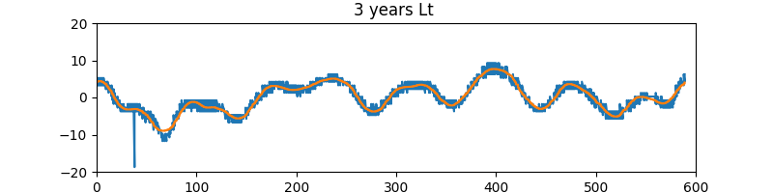
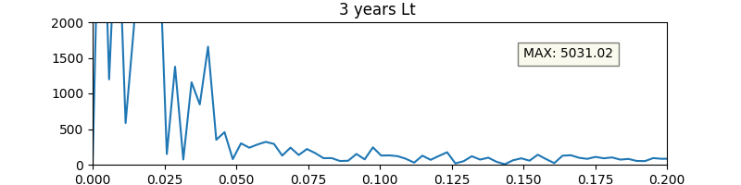
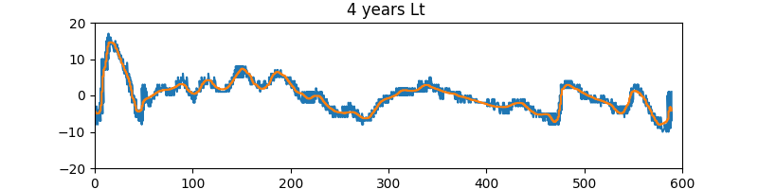
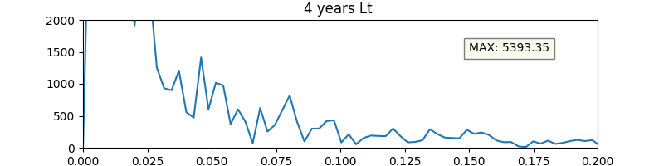
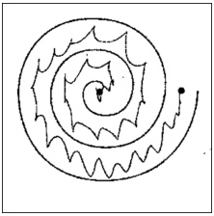
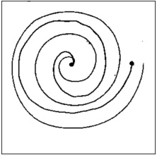
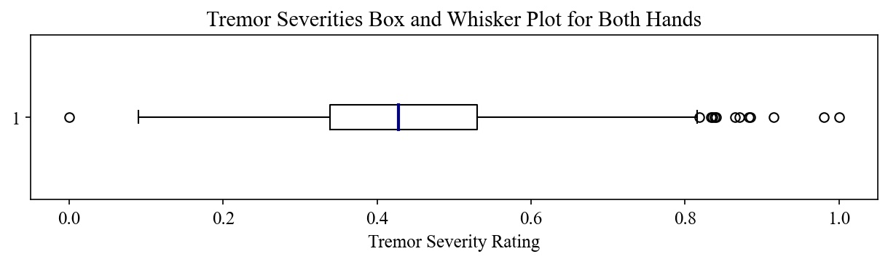
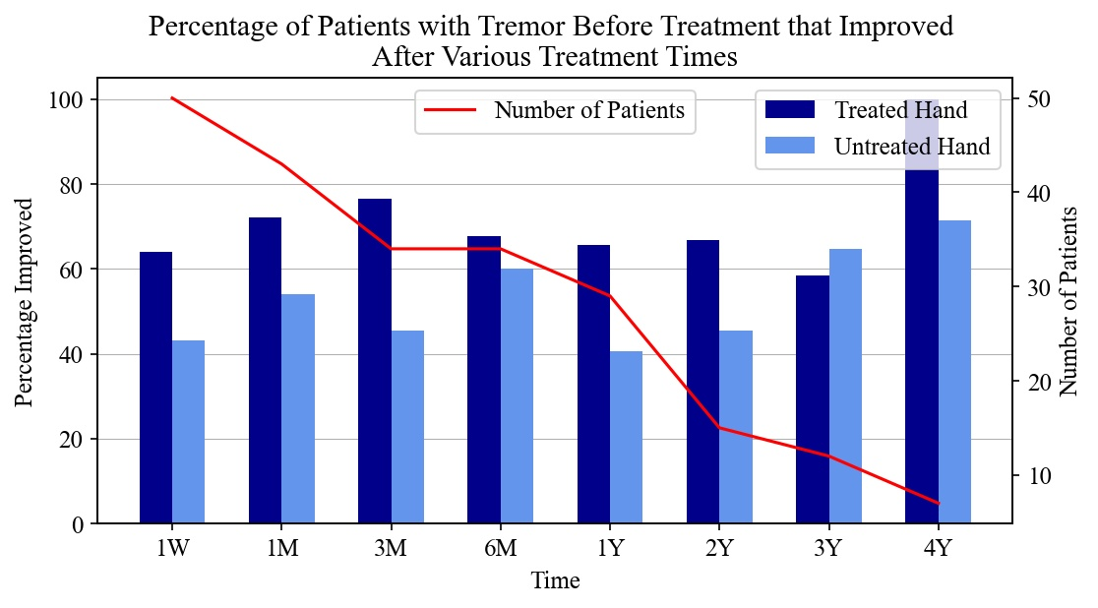
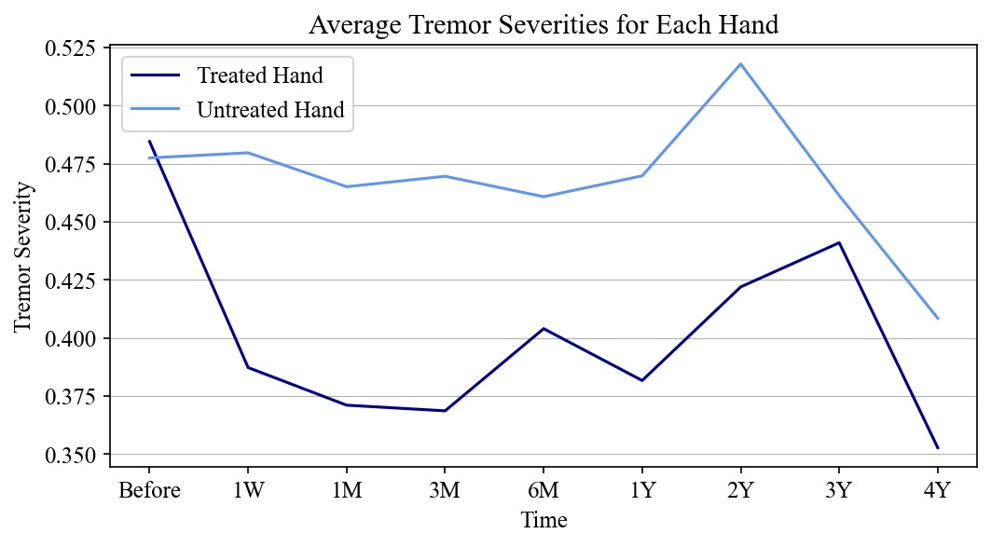
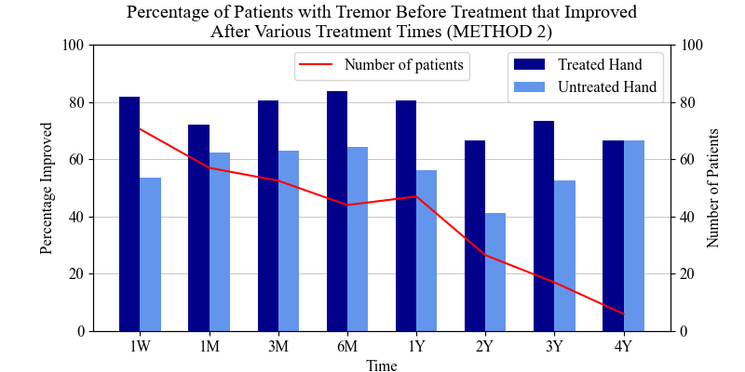
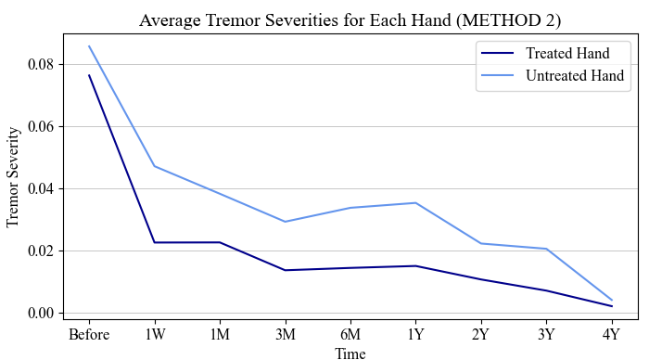
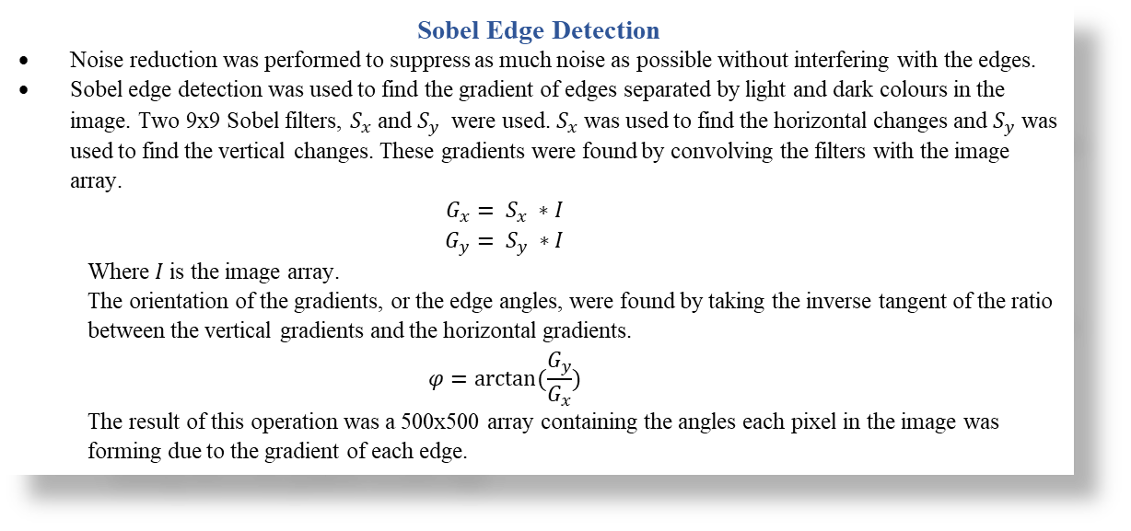
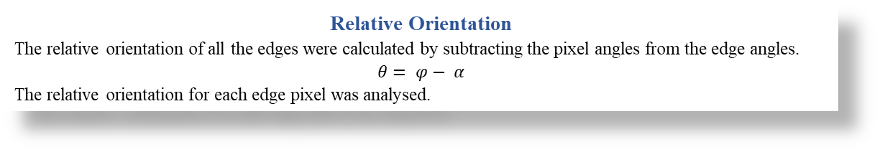
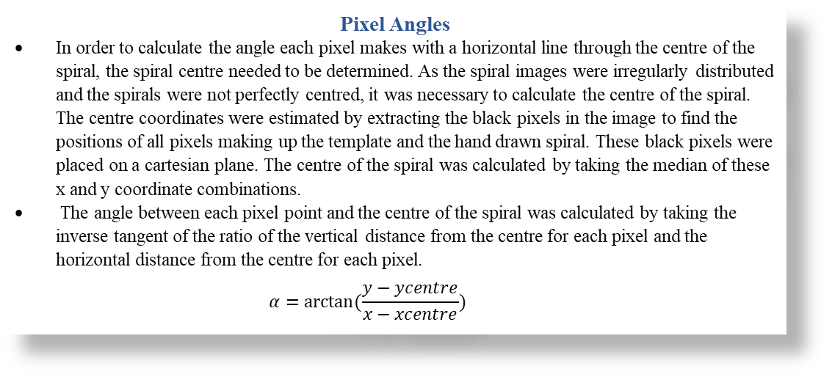
Background
Focused Ultrasound Treatment (FUS) is a promising treatment for movement disorders such as Essential Tremor and Parkinson’s Disease. Essential Tremor is a common disorder amongst people over the age of 60 years. The disorder includes the presence of a tremor in the hands that can be incredibly disruptive for the patient [1]. Parkinson’s Disease is a neurological disorder that leads the patient to have uncontrollable movements [2]. Parkinson’s Disease causes changes in the body’s muscle control, speech and writing ability and leads to a tremor in the hand and fingers.
FUS is a new treatment technique that has been proven to have a therapeutic effect on brain disorders. FUS is a non-invasive treatment that functions by delivering sound waves to the patient’s thalamus, the part of the brain responsible for relaying sensory and motor signals, resulting in the formation of a permanent lesion in this region of the brain [3][4]. This lesion acts to interrupt abnormal brain activity, reducing uncontrollable movements associated with Essential Tremor and Parkinson’s Disease. FUS is only performed on one side of the brain, thus it only improves the movement on one side of the body. This treatment has been seen to result in immediate reduction in tremor in the side of the body receiving treatment.
This study will focus on FUS as a treatment for patients with Essential Tremor and Parkinson’s Disease in an attempt to determine whether the treatment is successful in reducing tremor, slowing the progression of these conditions. The Rambam Medical Center, Haifa Israel, has given permission for the secondary usage of their database relating to “Hand drawing tests of Parkinson’s disease and Essential Tremor patients under treatment” for this investigation project. This data comprises of 122 fully anonymised hand drawn shapes on paper that patients and drew over time of treatment with both their treated and untreated hand [5].
Which Hand?
Robyn Gebbie and Jesse van der Merwe
Aim
Quantitatively investigate the efficacy of the FUS treatment by investigating computational and statistical analysis of spiral drawings. Provide insight about the extent that these results can be used to assess the severity of tremor on the patient’s treated or untreated side after the treatment.
Time | Number of peaks | Average adjacent peak distance | Tremor severity | Original drawing | Plotted points and function | FFT
Before | 12 | 5.81 | 69.67
1W | 4 | 6.79 | 27.18
3M | 4 | 3.27 | 13.07
1Y | 7 | 2.43 | 17.02
2Y | 8 | 2.88 | 23.06
3Y | 4 | 3.77 | 15.10
4Y | 26 | 1.25 | 32.49
Before | 8 | 4.95 | 39.58
1W | 9 | 6.33 | 56.97
3M | 13 | 3.97 | 51.60
1Y | 16 | 6.18 | 98.81
2Y | 11 | 2.23 | 24.55
3Y | 10 | 5.48 | 54.79
4Y | 14 | 5.44 | 76.11
STEP 1: Data Analysis
Out of the 122 patients, 34 are undergoing treatment for Parkinson’s Disease, and the remaining 88 for Essential Tremor, however, it was decided to group all patients together as the aim of this project does not differentiate between disease/disorder, but only on success of treatment.
On each template that patients have to draw on, there are two distinct sections: Drawing A and B – spiral drawings, Drawing C – straight line drawings.
STEP 2: Cropping
Focused Ultrasound Treatment (FUS) is a promising treatment for movement disorders such as Essential Tremor and Parkinson’s Disease. Essential Tremor is a common disorder amongst people over the age of 60 years. The disorder includes the presence of a tremor in the hands that can be incredibly disruptive for the patient [1]. Parkinson’s Disease is a neurological disorder that leads the patient to have uncontrollable movements [2]. Parkinson’s Disease causes changes in the body’s muscle control, speech and writing ability and leads to a tremor in the hand and fingers.
STEP 3: Clean-up of Results
Focused Ultrasound Treatment (FUS) is a promising treatment for movement disorders such as Essential Tremor and Parkinson’s Disease. Essential Tremor is a common disorder amongst people over the age of 60 years. The disorder includes the presence of a tremor in the hands that can be incredibly disruptive for the patient [1]. Parkinson’s Disease is a neurological disorder that leads the patient to have uncontrollable movements [2]. Parkinson’s Disease causes changes in the body’s muscle control, speech and writing ability and leads to a tremor in the hand and fingers.
Data Analysis and Pre-Processing
Analysis of Edge Angles in Spiral
The severity of the spiral drawings was assessed using edge detection to determine the gradient of every pixel in the spiral. This gradient was used to find the orientation of each edge in the spiral relative to the centre of the spiral. The relative orientation of each edge provided the means to determine the distribution of edge angles throughout the drawing, providing insight on the tremor severity of the hand drawn spiral.
Spiral Drawing Tremor Quantification
Sobel Edge Detection
Noise reduction was performed to suppress as much noise as possible without interfering with the edges.
Sobel edge detection was used to find the gradient of edges separated by light and dark colours in the image. Two 9x9 Sobel filters, $S_{x}$ and $S_{y}$ were used. $S_{x}$ was used to find the horizontal changes and $S_{y}$ was used to find the vertical changes. These gradients were found by convolving the filters with the image array.
$$G_{x}= S_{x} ∗I$$
$$G_{y}= S_{y} ∗I$$
Where $I$ is the image array.
The orientation of the gradients, or the edge angles, were found by taking the inverse tangent of the ratio between the vertical gradients and the horizontal gradients.
$$φ=arctan⁡(\frac{G_{y}}{G_{x}})$$
The result of this operation was a 500x500 array containing the angles each pixel in the image was forming due to the gradient of each edge.
Template
Before
Template
Pixel Angles
In order to calculate the angle each pixel makes with a horizontal line through the centre of the spiral, the spiral centre needed to be determined. As the spiral images were irregularly distributed and the spirals were not perfectly centred, it was necessary to calculate the centre of the spiral. The centre coordinates were estimated by extracting the black pixels in the image to find the positions of all pixels making up the template and the hand drawn spiral. These black pixels were placed on a cartesian plane. The centre of the spiral was calculated by taking the median of these x and y coordinate combinations.
The angle between each pixel point and the centre of the spiral was calculated by taking the inverse tangent of the ratio of the vertical distance from the centre for each pixel and the horizontal distance from the centre for each pixel.
$$α=arctan⁡(\frac{y−ycentre}{x−xcentre})$$
Template
Template
Relative Orientation
The relative orientation of all the edges were calculated by subtracting the pixel angles from the edge angles.
$$θ= φ− α$$
The relative orientation for each edge pixel was analysed.
Background
Tremor Quantification
The distribution of the relative orientation angles was plotted in the form of a histogram to outline the distribution of edge angles. The tremor severity of the spiral could be determined by analysing this histogram. The main indication of high tremor is a high standard deviation. A more widely distributed histogram indicates that the edge angles in the spiral vary considerably. The standard deviations for each spiral for each patient were determined and normalised to form a dataset quantifying each spiral tremor for each patient.
Spiral A
Spiral B
Normalised Standard Deviations of Edge Angles
 | Spiral A | Spiral B
Normalised Standard Deviation | 0.63 | 0.19
Analysis of FUS Treatment
In order to determine whether FUS treatment is successful in tremor reduction, tremor severity ratings calculated from the edge angle standard deviations were determined for each patient’s treated and untreated hands for each given treatment period. The average of each severity was calculated and plotted for each treatment period. The percentage of patients whose tremor improved when compared to their tremor before treatment was determined. It is important to note that the number of patients that went for treatment greatly decreases as time progresses which affects the reliability of the later years’ results. Overall, the treatment appears to be successful, with an average of 71% of the treated hands seeing an immediate improvement in tremor severity after treatment and a clear immediate decrease in the average tremor severity after treatment begins.

